Slide 1
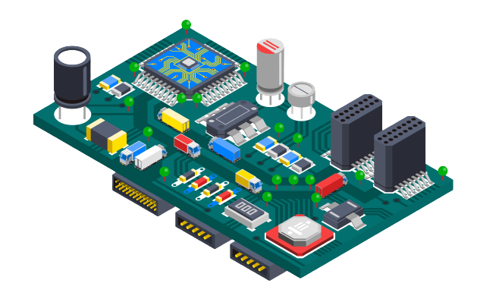
Smart Doorbell System
Here is where your presentation begins

Slide 2

What is a Microcontroller ?
1
A microcontroller is a small, single-chip computer used to connect to and control other devices. A typical microcontroller consists of some or all of these parts:
CPU
Memory
Ports

Slide 3
Important points:
1
2
3
Central processing unit (CPU)
Memory
Ports
The CPU is the brains of the microcontroller. Its job is to find the instructions in memory and decode them to make them usable by the microcontroller.
the microcontroller instructions as well as variables and their changing values get stored in memory and can be accessed by the CPU when needed.
Microcontrollers generally have both input and output ports where devices like sensors, LEDs, and displays can be attached.

Slide 4
Microcontroller | ATmega328
Operating Voltage | 5V
Input Voltage (recommended) | 7-12V/ Input Voltage (limits) 6-20V
Digital I/O Pins | 14 (of which 6 provide PWM output) 6 Analog Input Pins
DC Current per I/O Pin | 40 mA (DC Current for 3.3V Pin 50 mA)
Flash Memory | 32 KB (ATmega328) of which 0.5 KB used by bootloader 2 KB
SRAM | (ATmega328)
EEPROM | 1 KB (ATmega328)
Clock Speed | 16 MHz
Length | 68.6 mm
Width | 53.4 mmS

Slide 5
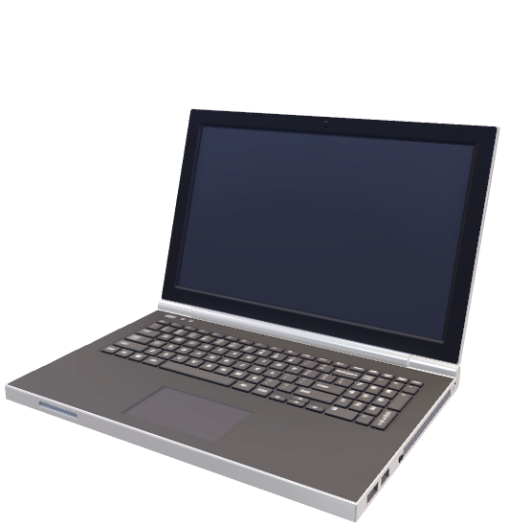
02
Ultrasonic Sensor

Slide 6
Ultrasonic ranging module HC - SR04 provides 2cm - 400cm non-contact measurement function, the ranging accuracy can reach up to 3mm.
The module includes ultrasonic transmitters, a receiver and a control circuit.

Slide 7
03
The basic principle behind its working

Slide 8
Using IO trigger for at least 10us high level signal, the Module automatically sends eight 40 kHz and detect whether there is a pulse signal back. If the signal is back, through high level , time of high output IO duration is the time from sending ultrasonic to returning it.

Slide 9
Equipments:
Electric Parameter
Working Voltage DC 5 V
Working Frequency 40Hz
Range 4m / Min Range 2cm
Measuring Angle 15 degree
5V Supply
- Trigger Pulse Input
- Echo Pulse Output
- 0V Ground

Slide 10
Timing diagram:
Supply a short 10uS pulse to the trigger input for starting the ranging
Module will send out “8 cycle burst” of ultrasound at 40 kHz to raise its echo
You can calculate the range through the time interval between sending trigger signal and receiving echo signal by uS / 58 (in centimetres) or uS / 148 (in inch) Range = high level time * velocity (340M/S) / 2

Slide 11

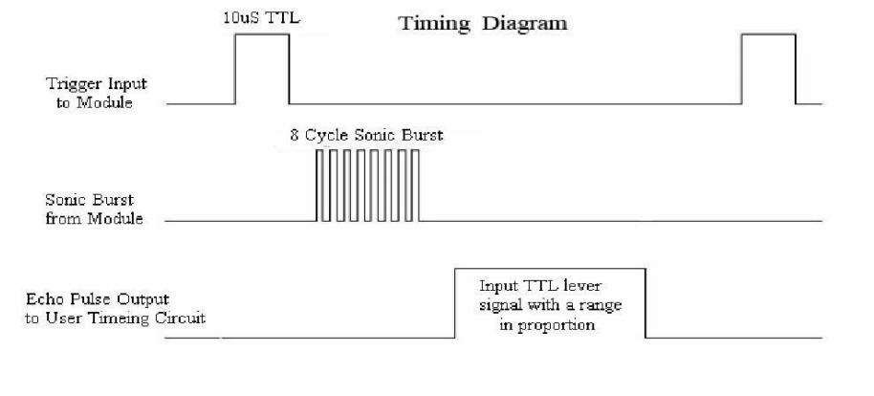
Diagram:

Slide 12
Automatic door system with LED ( electronic circuit ) :
This is the circuit of our system realized with LED instead of DC motor The concept is the same .

Slide 13
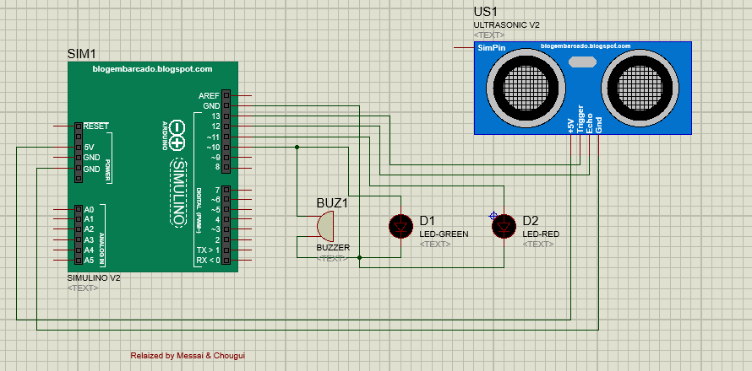
Main diagram:

Slide 14


The tasks

Slide 15
First task
Measure the distance and display it on the Red LED
Second task
Detect the obstacle (human) under 50cm of distance and open the door or power on the green LED
How does it work ?
When the distance measured is less than 50cm means that there is obstacle in the range of 0-50 cm from the ultrasonic sensor ( door ).

Slide 16
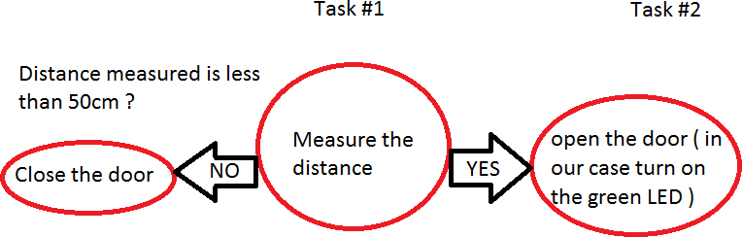
Main diagram:

Slide 17
Function mode: We have three Modes in this simple system, Cycle, Event and Mixt
Cycle: sending periodic signal over and over from trig Output
Event :Waiting for the signal return, receiving from echo Input
Mixt :Sending and receiving the signal , And display the distance on LED, also play a sound if obstacle is detected

Slide 18
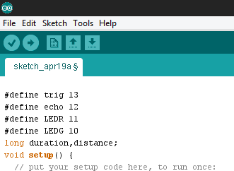
Main diagram:

Slide 19
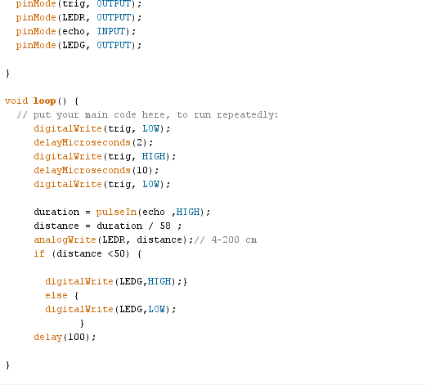
Main diagram:

Slide 20
Thank you

